Slide 1
Chapter 1:
Rational Numbers
Lesson 3:
Adding & Subtracting Rational Numbers
Let’s explore English in Maths
Grade 7

Slide 2
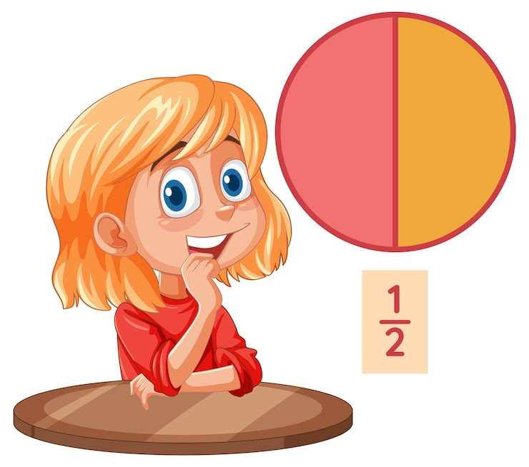
Warm-up
Look and Choose

Slide 3
Warm-up
How to play
Students look at the pictures.
Raise your hands to choose the correct fraction.
If the answer is correct, the team earns 1 point.
Continue with the remaining questions.
The student or team with the most points wins.
Look and choose

Slide 4





PANDA
PANDA
0967 255 149 Thanh Yen Tran

Slide 5

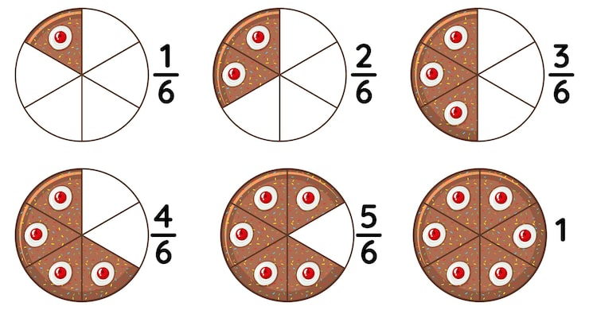




Choose the correct fraction.
A. | B.
C. | D.
A
B
C
D

Slide 6
Choose the correct fraction.
A. | B.
C.
A
B
C

Slide 7
Choose the correct fraction.
A. | B.
C. | D.
A
B
C
D

Slide 8
Choose the correct fraction.
A. | B.
C. | D.
A
B
C
D

Slide 9
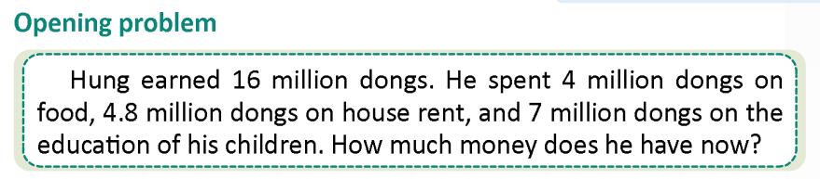
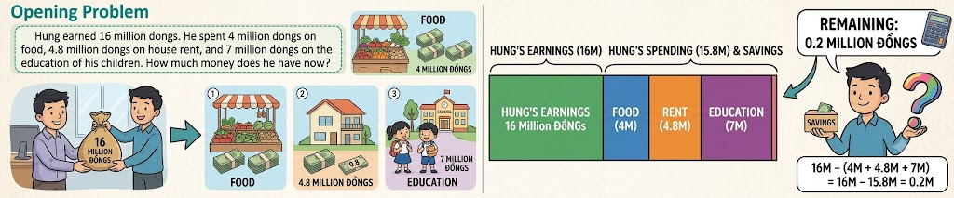
Lead-in
Hung’s costs: 4 + 4.8­­ + 7 = 15.8 million
Hung’s money left: 16 – 15.8 = 0.2 million
Hung has 0.2 million dongs left now

Slide 10
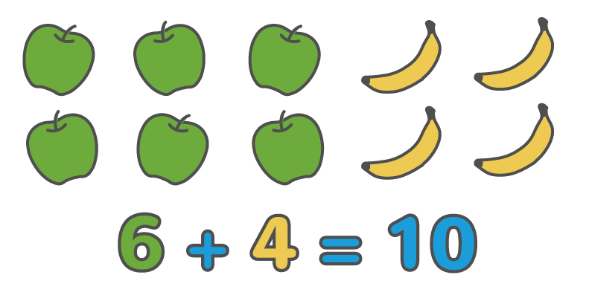
Vocabulary
addition
/əˈdɪʃ.ən/
The process of adding numbers or amounts together.

Slide 11
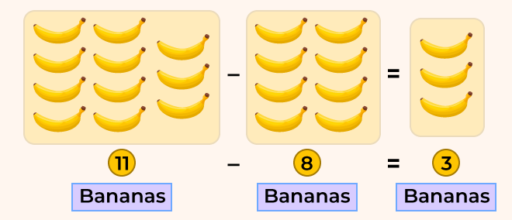
Vocabulary
subtraction
/səbˈtræk.ʃən/
The process of taking away a number from another.

Slide 12
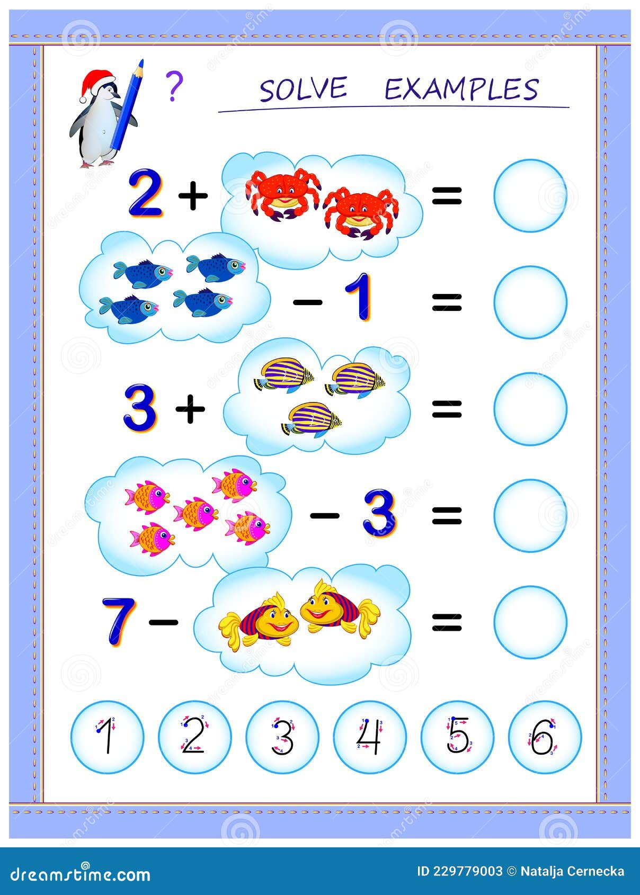
Review
Classify the operations into the correct columns.
addition
subtraction
4
3
2
6

Slide 13

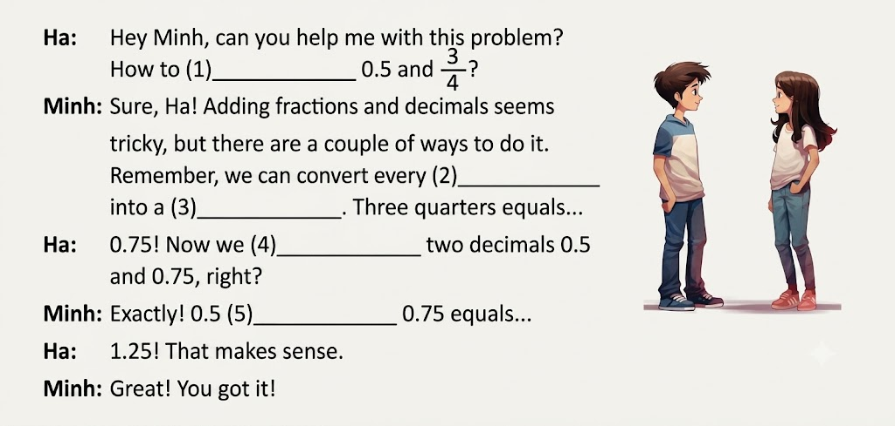
A. Listening
Listen and fill in the blanks using suitable words.
add
fraction
decimal
add
plus

Slide 14
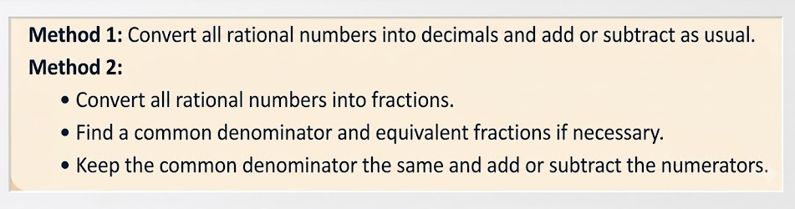

Math corners
How to add or subtract rational numbers?
There are a couple of ways to do that.

Slide 15
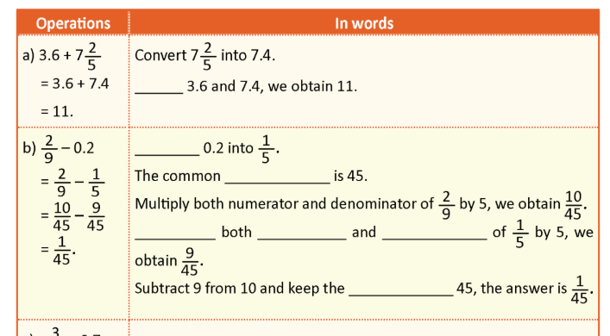
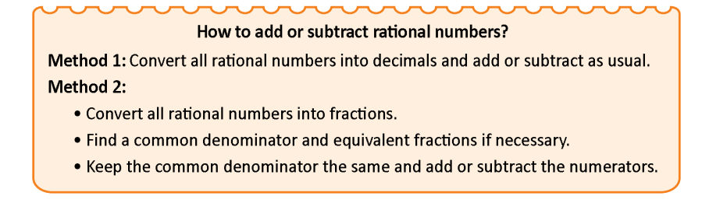
C. Writing
Fill in the blanks to express the process of the following operations in words.
Add
Convert
denominator
Multiply
numerator
denominator
denominator

Slide 16
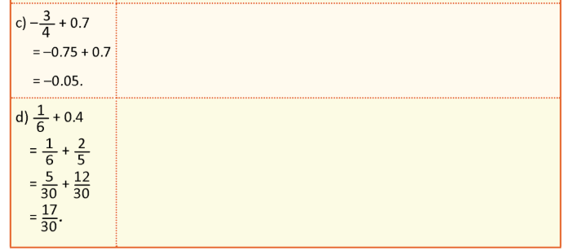
C. Writing
Fill in the blanks to express the process of the following operations in words.
3
Convert - into -0.75.
Add -0.75 and 0.7, we obtain -0.05.
4
2
Convert 0.4 into .
The common denominator is 30.
Multiply both N and D of by 5, we obtain .
Multiply both N and D of by 6, we obtain .
Add and , we obtain .
5
1
5
6
30
2
12
5
30
5
12
17
30
30
30

Slide 17
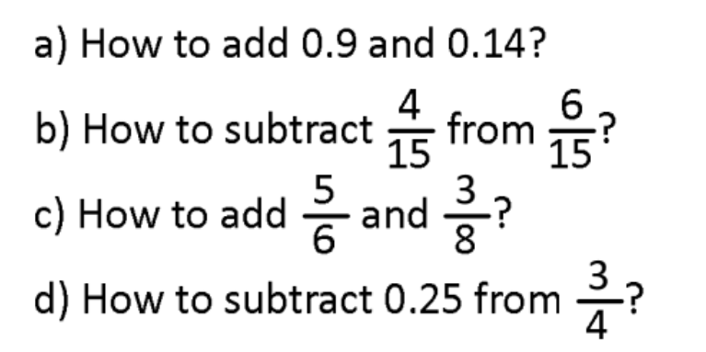

B. Speaking
Work in pairs,
Ask and answer the following questions.

Slide 18
B. Speaking
Work in pairs,
Ask and answer the following questions.
Add 0.9 and 0.14, we obtain 1.04.

Slide 19
B. Speaking
Work in pairs,
Ask and answer the following questions.
Subtract numerator 4 from 6 and keep denominator 15, the answer is .
2
15

Slide 20
B. Speaking
Work in pairs,
Ask and answer the following questions.
The common denominator is 24.
Multiply both numerator and denominator of by 4 and by 3, we obtain and .
Add the numerator 20 and 9, keep the denominator 24, the answer is
5
3
20
6
9
8
24
24
29
24

Slide 21
B. Speaking
Work in pairs,
Ask and answer the following questions.
1
Convert 0.25 into
Subtract 1 from 3 and keep the denominator 24, we obtain
The simplest form of is
4
2
4
2
1
4
2

Slide 22

D. Writing
Solve the following problems.
The length of candle now:
12 – 2.3 = 9.7 (cm)

Slide 23
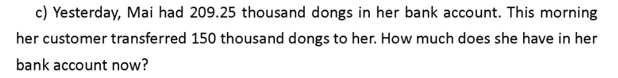
D. Writing
Solve the following problems.
Mai’s money in her bank account:
209.25 + 150 = 359.25 (thousand dongs)
Therefore, she has 359.25 thousand dongs in her bank account.

Slide 24
Consolidation
Vocabulary: addition, subtraction.
Know and do exercises about addition and subtraction of rational numbers.
Sentence Patterns:
+ Convert all rational numbers into decimals and add or subtract as usual.
+ Convert all rational numbers into fractions – Find the common denominator – Keep the common denominator – Add or subtract numerators.

Slide 25
Homework
- Review the vocabulary about Adding and Subtracting Rational Numbers.
- Memorize the two methods for adding and subtracting rational numbers.
- Do exercise D. Writing – b.
- Prepare a new lesson: Lesson 4.

Slide 26
"Count the steps.
Speak the logic."

